Slide 1

Cyber-Crime Data Analysis
(INDIA)
2017 - 2022
Data Source – India Data portal
Submitted By – Pratyaksh Pandey
Notes:
1

Slide 2

Objective
To gain actionable insights from cybercrime data.
Proactive Defense
Improved Incident Response
Identify and mitigate potential threats before they impact critical systems.
Respond to cyberattacks quickly and effectively, minimizing damage and downtime.
Notes:
4

Slide 3
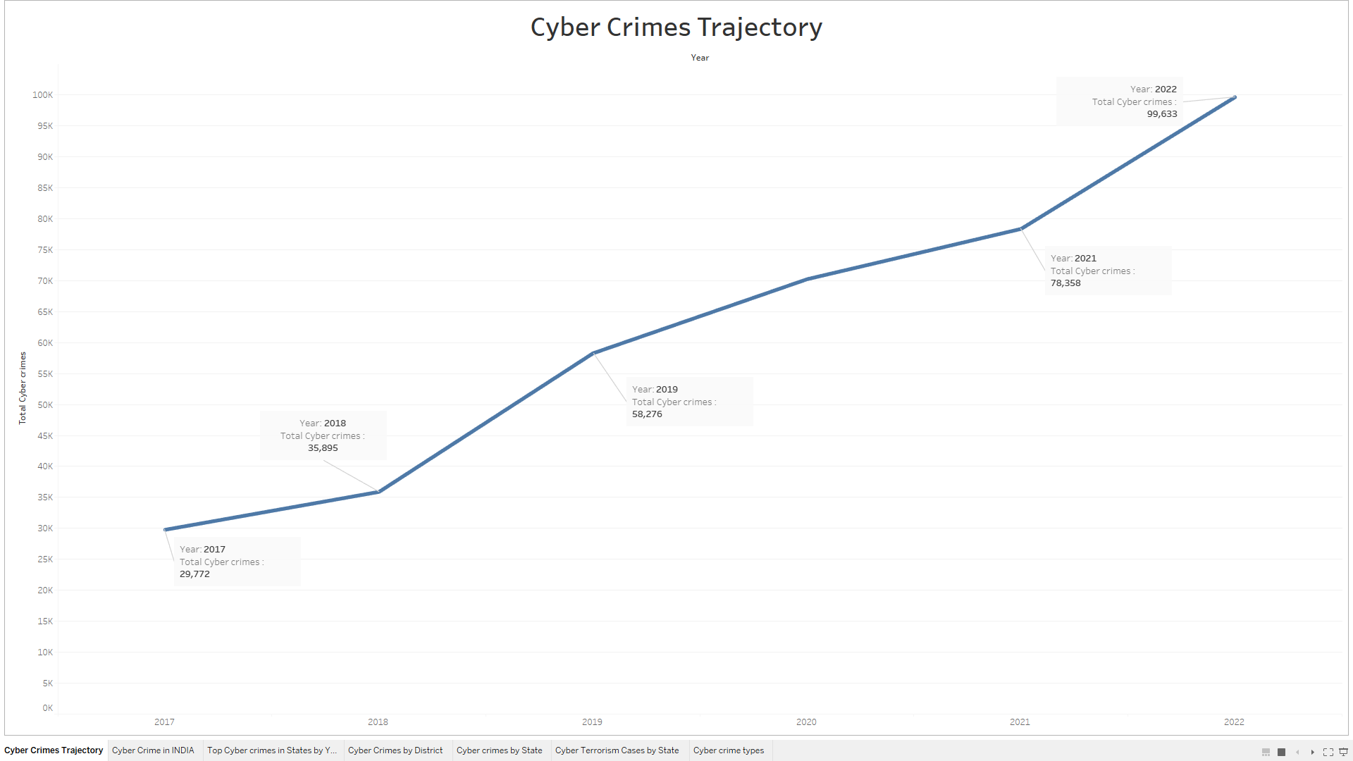
Data Visualizations

Slide 4
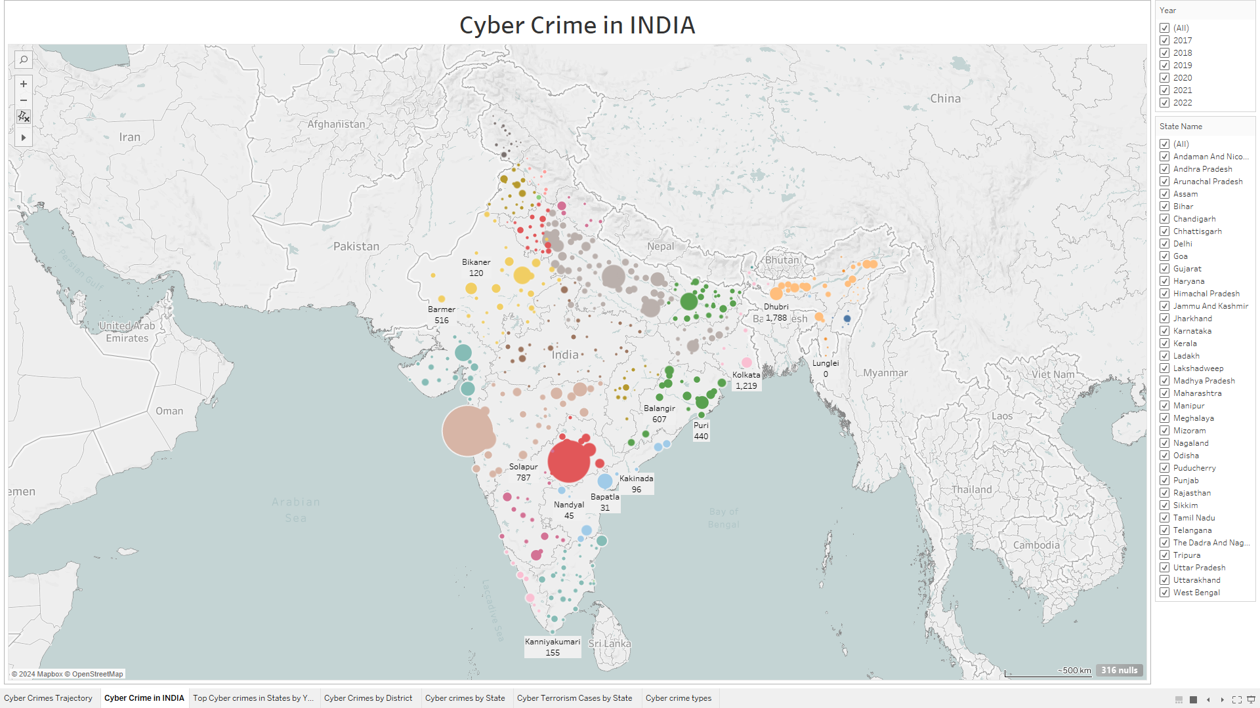

Slide 5
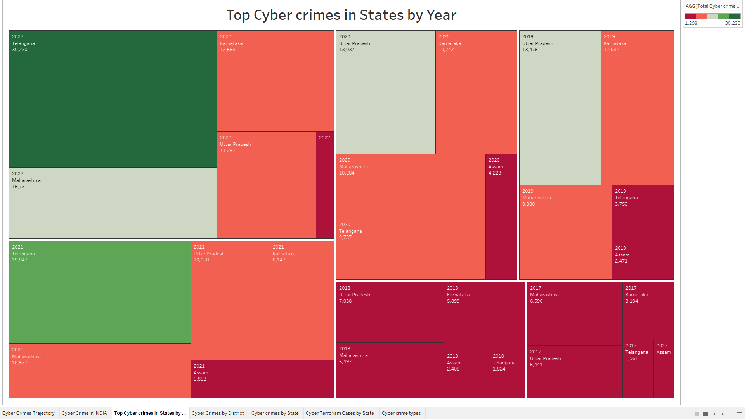

Slide 6
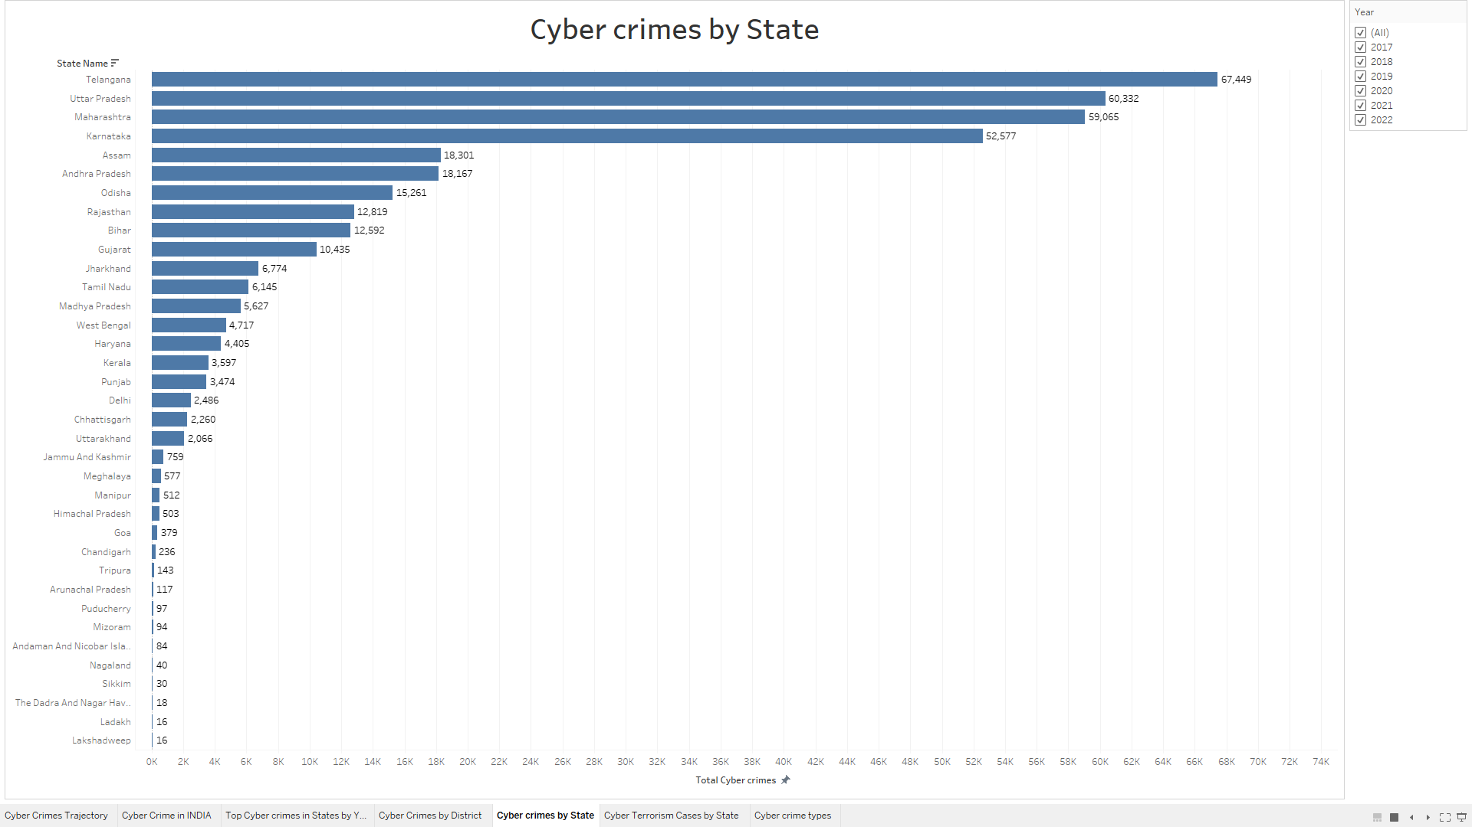

Slide 7
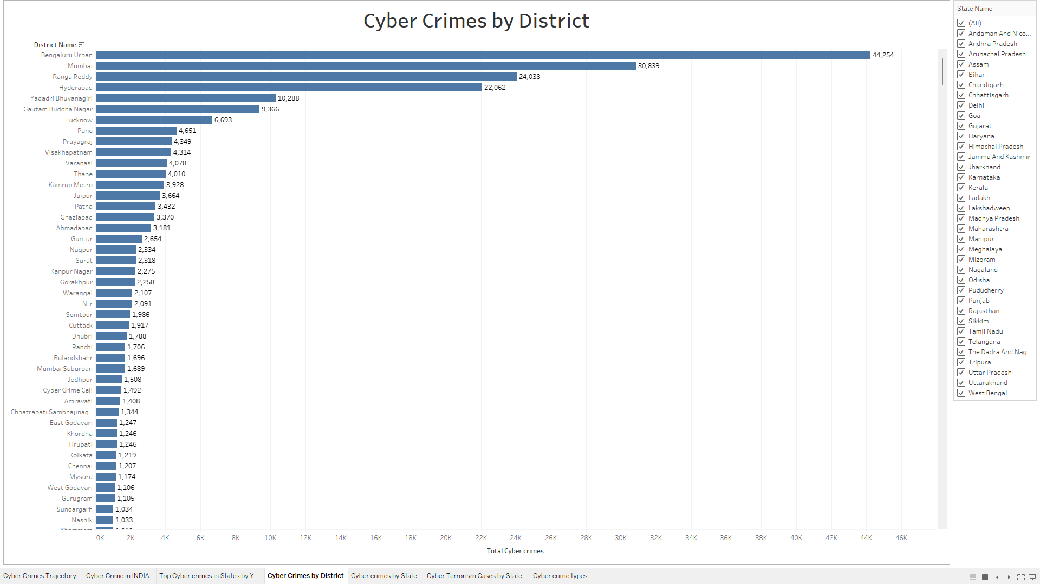

Slide 8
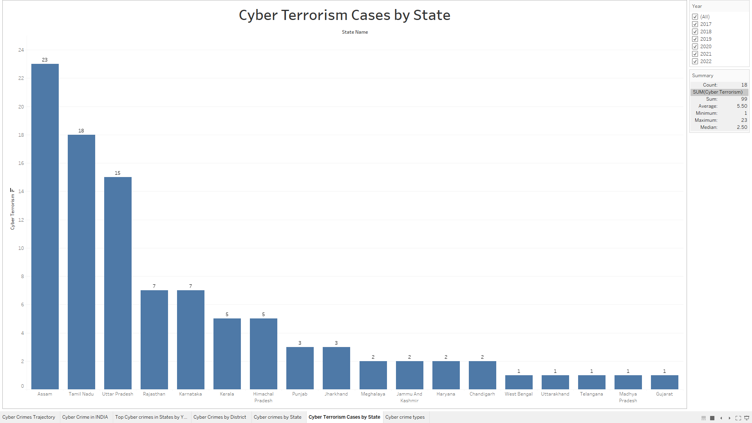

Slide 9
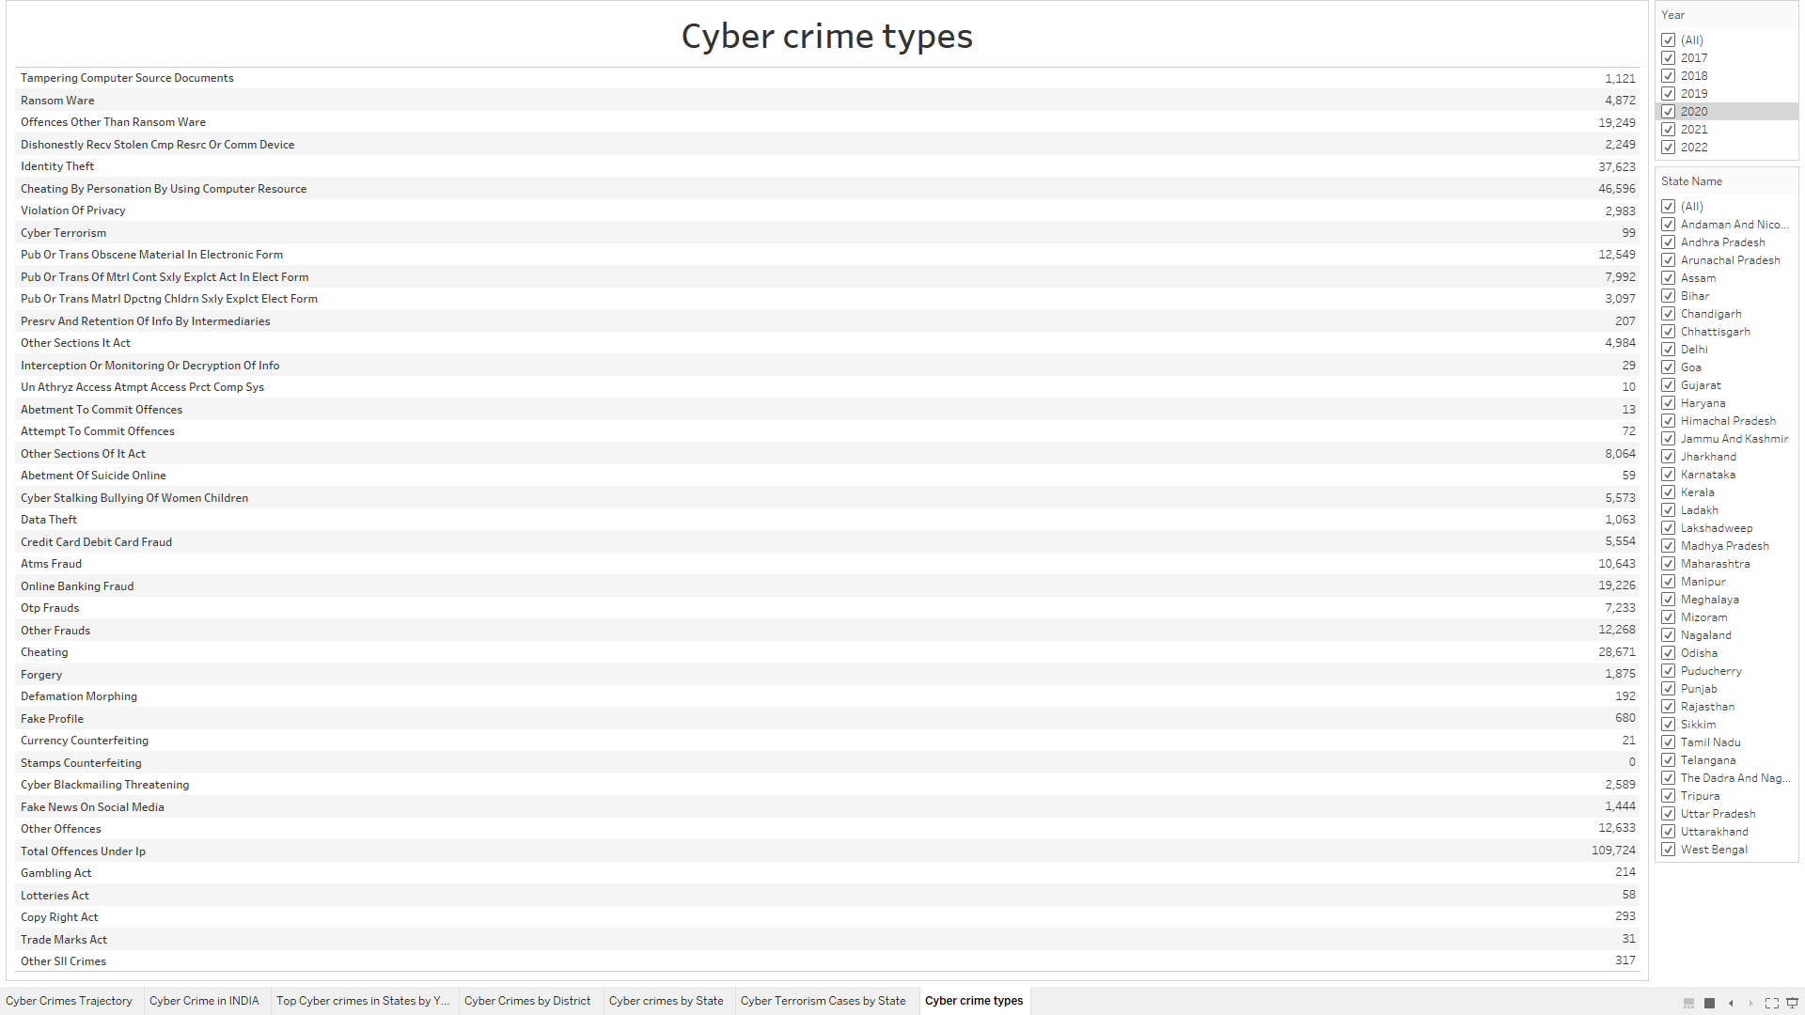

Slide 10

Key Findings
Crime Pattern Evolution
Shift from traditional cyber frauds to sophisticated digital crimes.
Emergence of new categories like ransomware and cyber stalking.
Increasing incidents of identity theft and online banking fraud.
Regional Insights
Higher reporting rates in metropolitan areas.
Varying patterns between urban and rural districts.
State-specific cybercrime characteristics.
Temporal Trends
Year-over-year increase in cyber crime registration.
Seasonal variations in certain types of cyber offenses.
Impact of digital adoption on crime patterns.
Notes:
2

Slide 11

Thank
You

